Slide 1


Chapter 4:
Machine Learning Model Training & Evaluation
Algorithm Benchmarking:
From High-Dimensional Sparse Features to Age Rating Prediction
Presenter:ZiHan Chen
Chapter 4:
Machine Learning Model Training & Evaluation
Algorithm Benchmarking:
From High-Dimensional Sparse Features to Age Rating Prediction

Slide 2
Modeling Challenges & Core Strategies
⚠ Data Challenges
🛡 Algorithm Diversity: Broad Evaluation
Evaluated 4 classic classification algorithms (Linear vs. Tree-based models) to capture different patterns in the sparse, high-dimensional data landscape.
1. High Dimensionality vs. Small Sample Size
Only 810 training samples, but expanded to 758 dimensions after One-Hot Encoding, leading to the classic "curse of dimensionality".
⚖ Imbalance Handling: Weighted Optimization
Enforced class_weight='balanced' across all models to automatically adjust weights inversely proportional to class frequencies, mitigating majority class bias.
2. Extreme Matrix Sparsity
The vast majority of features are marked as 'No' or 'INACTIVE', which drowns valid signals in a sea of zeros and reduces model sensitivity.
📊 Fair Benchmarking: Rigorous Validation
Applied strict 5-Fold Cross-Validation (GridSearchCV) uniformly to all models, ensuring a consistent, unbiased comparison of performance metrics.
3. Severe Class Imbalance
Uneven distribution across 5 age rating categories risks the model being biased towards the majority class.

Slide 3
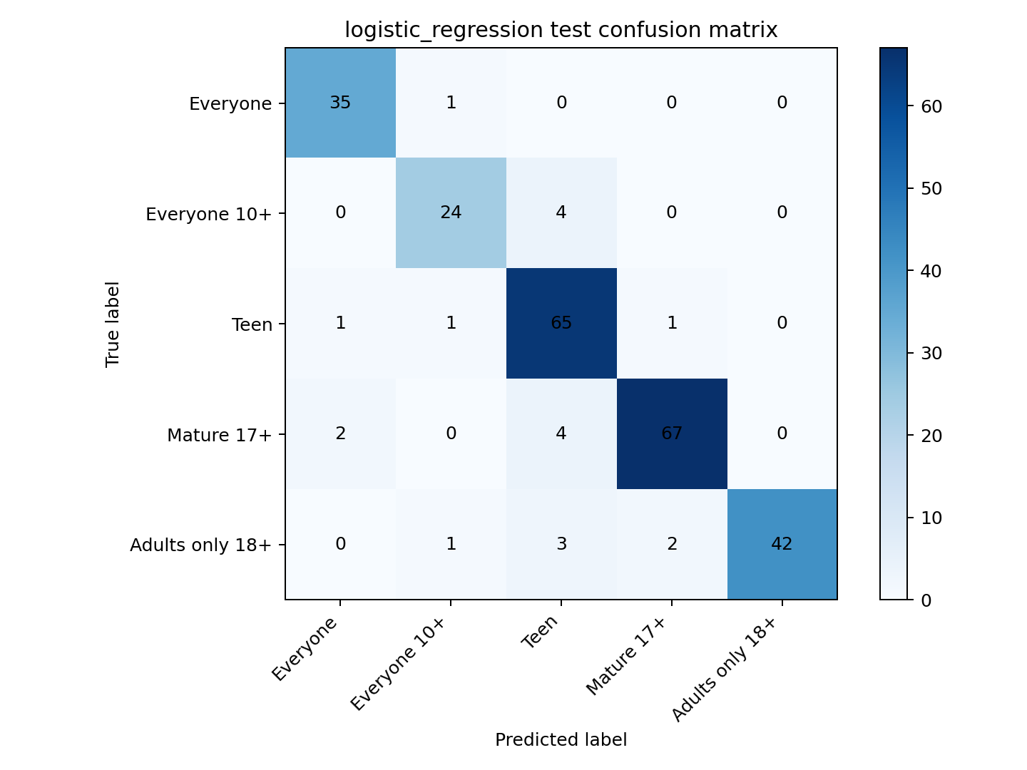
Model 1: Logistic Regression (The Sparse Champion)
🔄 Model Intro
A classic linear classifier utilizing regularization penalties. It is naturally suited for high-dimensional and extremely sparse feature spaces.
⚙ Training Process
Conducted an exhaustive Grid Search with 53 parameter combinations via 5-Fold CV. The tuning focused on the regularization penalty (l1_ratio), inverse regularization strength (C), and adopting the saga solver optimized for large sparse datasets.
Test Set Accuracy
0.921
Macro F1 Score
0.918
📊 Optimal Hyperparameters:
l1_ratio=1.0 (Pure L1 Lasso),C=10.0, solver='saga'
💡 Insight: Pure L1 Regularization automatically triggered extreme feature selection.

Slide 4
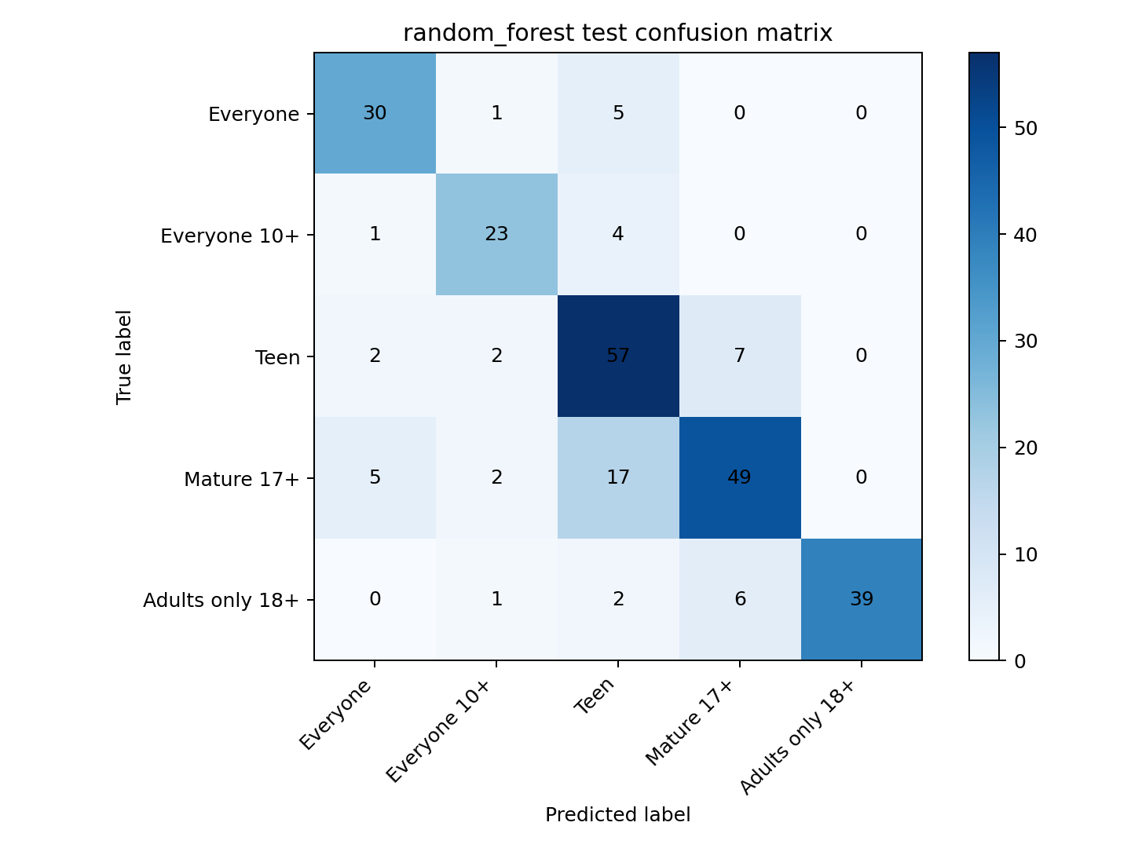
Model 2: Random Forest (The Unconstrained Baseline)
🔄 Model Intro
A classic Bagging ensemble model that builds multiple decision trees to capture complex non-linear relationships.
⚙ Training Process
Performed a 162-combination Grid Search (5-Fold CV) to optimize tree splitting mechanics. The search space heavily explored maximum tree depth (max_depth), minimum leaf samples (min_samples_leaf), and feature sampling rates (max_features).
Test Set Accuracy
0.783
Macro F1 Score
0.797
📊 Optimal Hyperparameters:
max_depth=None, min_samples_leaf=1, max_features=0.3
⚠Warning: max_depth=None led to severe overfitting (memorization) on the small training set.

Slide 5
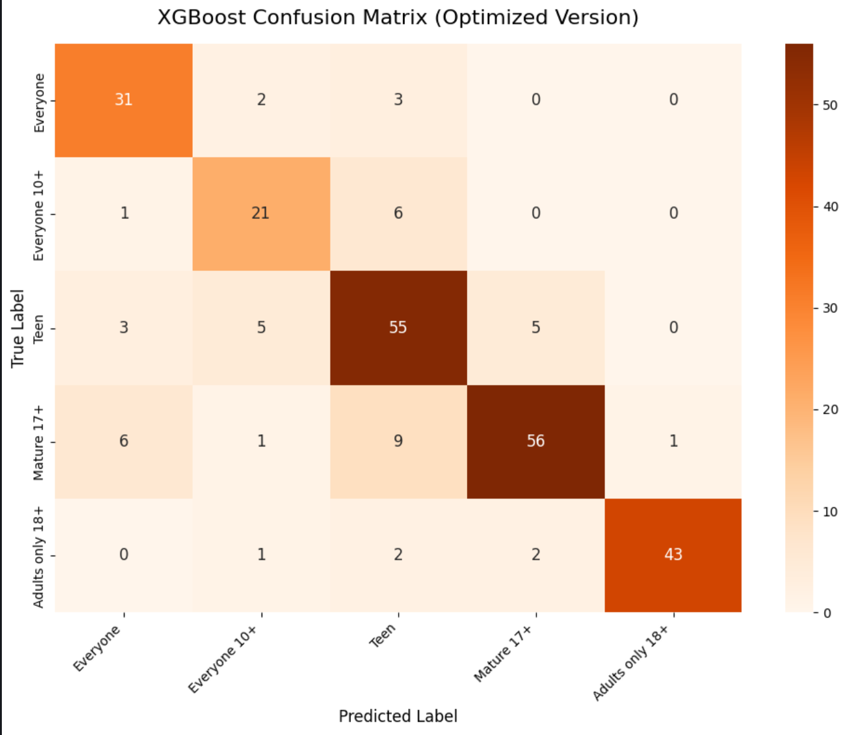
Model 3: XGBoost (The Robust Performer)
🔄 Model Intro
A highly optimized Gradient Boosting Decision Tree (GBDT) framework with built-in sparsity-aware split finding.
⚙ Training Process
Implemented a 2-stage training pipeline to prevent overfitting.
Stage 1: Anti-overfitting Grid Search limiting tree depth and feature sampling.
Stage 2: Final training with 500 estimators utilizing Early Stopping (patience=30) monitored on an independent validation set.
Test Set Accuracy
0.814
Macro F1 Score
0.810
📊 Optimal Hyperparameters:
max_depth=6, colsample_bytree=0.8, subsample=1.0
🛡 Strategy: Constrained depth feature sub-sampling forced the model to learn true generalized rules.

Slide 6
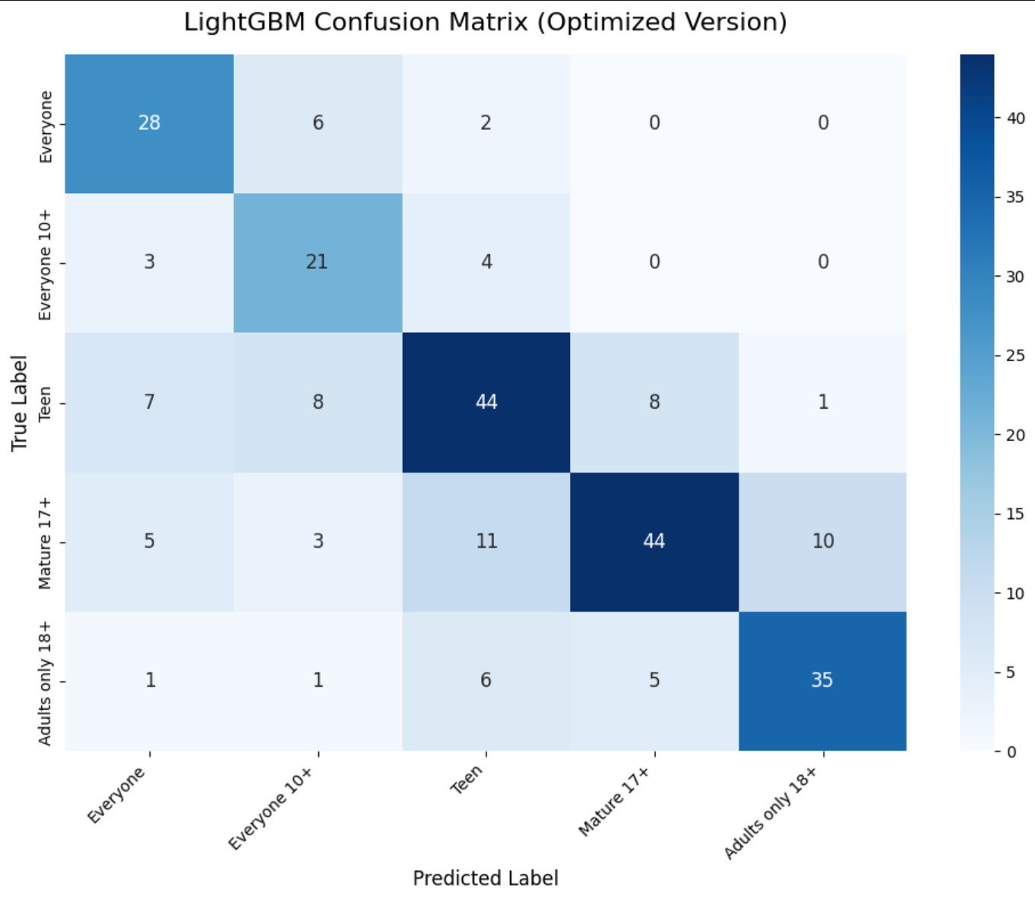
Model 4: LightGBM (The Constrained Underdog)
🔄 Model Intro
A lightweight GBDT framework known for its fast Histogram-based algorithms and aggressive Leaf-wise growth strategy.
⚙ Training Process
Configured to single-thread mode (n_jobs=1) to bypass C++ OpenMP deadlocks caused by small datasets. Applied rigorous Grid Search focusing on extreme leaf capacity constraints (min_child_samples) to curb its over-aggressive growth, followed by Early Stopping training.
Test Set Accuracy
0.780
Macro F1 Score
0.780
📊 Optimal Hyperparameters:
min_child_samples=15, num_leaves=15, max_depth=6
📉 Diagnosis: High leaf capacity thresholds forced the model to ignore rare but critical 'red-line' triggers

Slide 7
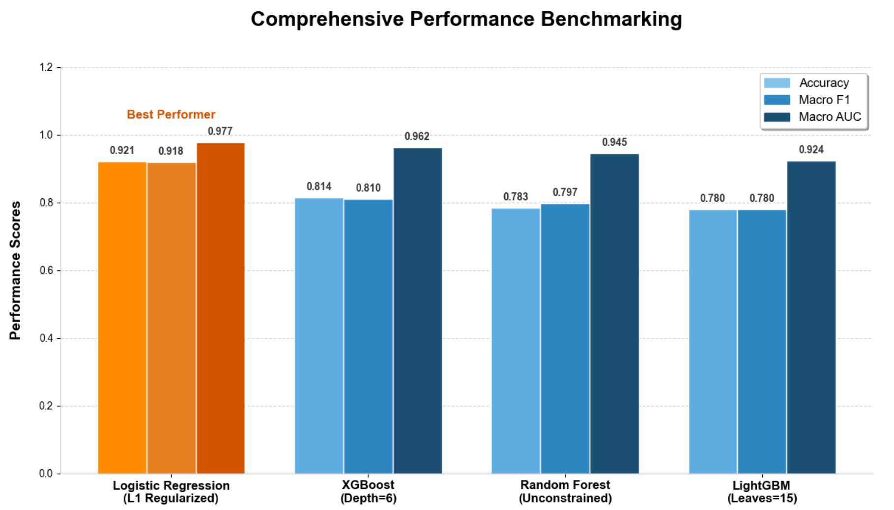
Comprehensive Performance Benchmarking
📈 Performance Insights: The Unexpected Winner
Through a horizontal comparison of three key indicators: Accuracy, Macro F1, and Macro AUC, we found that Logistic Regression (marked in orange) outperforms more complex tree-based ensemble models in all dimensions. It not only leads in numerical values but also has an overwhelming advantage in training efficiency and interpretability.
💡Core Conclusion
Under strict fair benchmarking, Logistic Regression outperforms complex tree models by a significant margin. This reaffirms that for this specific problem space, simplicity and linearity yield more robust and generalizable results than over-parameterized models.

Slide 8
The " Why " : Decrypting the Algorithmic Divergence
✅ The Triumph of Logistic Regression:
Sparsity Meets Business Logic
❌ Unconstrained Tree Models (e.g., Random Forest)
Suffer from severe overfitting (memorization) when processing high-dimensional wide tables. They capture random noise as patterns, failing to generalize to unseen critical cases in the app rating dataset.
Algorithmic Behavior: Pure L1 Regularization
Pure L1 Regularization (Lasso) successfully compressed 80.6% of redundant feature weights to exactly 0.
Perfect Business Mapping: " One-Strike Veto "
This mathematically perfectly aligns with Google Play's underlying " One-Strike Veto" logic (e.g., ticking 'Gore' immediately triggers a 17+ rating, regardless of other benign answers).
❌ Constrained Tree Models (e.g., XGBoost/LightGBM)
When we apply strict anti-overfitting rules (like min_child_samples), the algorithms treat "extremely rare but fatal violations" as minor noise and actively filter them out, causing a drop in accuracy.

